Slide 1
Far-Infrared Motion Detectors

Slide 2
Far-Infrared Motion Detectors
Operates in the optical range of thermal radiation.
Responsive to radiative heat exchange between the sensing element and moving object.
The principle of thermal motion detection is based on the physical theory of natural emission of electromagnetic radiation from any object whose temperature is above absolute zero.
It is essential that surface temperature of an object be different from that of the surrounding objects.

Slide 3
Far-Infrared Motion Detectors
If the object is warmer than the surroundings, its thermal radiation is shifted toward shorter wavelengths and the intensity becomes stronger.
For Instance.
Dielectric objects generally have high emissivity of thermal radiation.
Human skin is a quite good emitter of thermal radiation.

Slide 4
Types of the IR motion detectors
There are two types of the IR motion detectors:
Active Infrared Motion Detectors
Passive Infrared Motion Detectors

Slide 5
Active Infrared Motion Detectors
There are two systems on a development of the active infrared motion detector.
Active infrared motion detector (active infrared, motion detector, house security system)
Controller system.

Slide 6
Passive Infrared Motion Detectors
Device is designed to pick up infrared rays and detect any form of movement.
No energy is emitted from the sensor, thus the name passive infrared.
The PIR sensing element is responsive to mid and far-infrared radiation within a spectral range from approximately 4 to 20 (micro-meter).

Slide 7
Passive Infrared Motion Detectors
There are three types of sensing elements that are potentially useful for that detector:
Bolometers
Thermopiles
Pyroelectrics

Slide 8
Types of sensing elements
Bolometers. A bolometer is a device for measuring the power of incident electromagnetic radiation via the heating of a material with a temperature-dependent electrical resistance.
Thermopiles. Thermopile Sensors generate a small thermoelectric voltage proportional to the detected radiation. A thermopile is an electronic device that converts thermal energy into electrical energy. It is composed of several thermocouples connected usually in series or, less commonly, in parallel.

Slide 9
Types of sensing elements
Pyroelectrics. pyroelectric elements are used almost exclusively for motion detection thanks to their simplicity, low cost, high responsivity, and a broad dynamic range. A pyroelectric material generates an electric charge in response to a thermal energy ﬂow through its body. all pyroelectrics are also piezoelectric. absorbed heat causes the front side of the sensing element to expand.

Slide 10
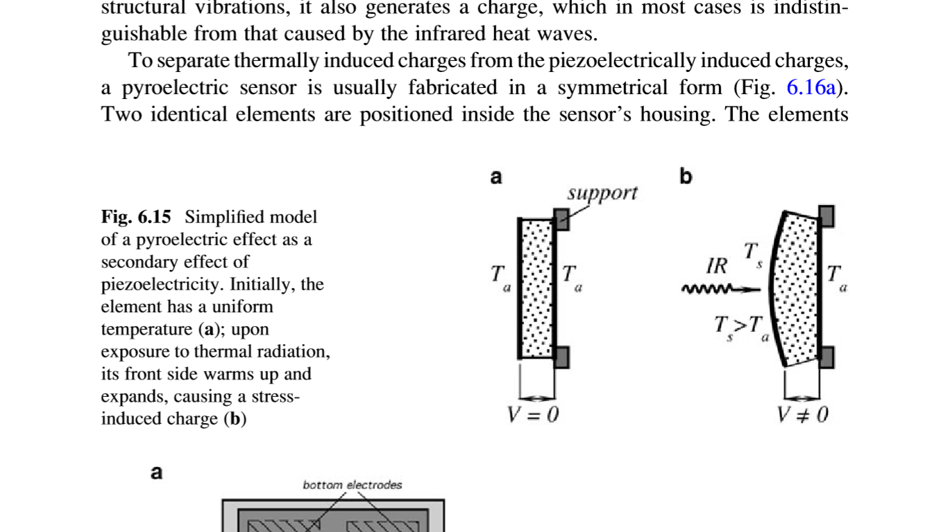
Pyroelectrics

Slide 11
Stefan-Boltzmann Law
The Stefan–Boltzmann law states that the total energy radiated per unit surface area of a black body across all wavelengths per unit time, is directly proportional to the fourth power of the black body's thermodynamic temperature T.
j^{k}=ƍT⁴

Slide 12
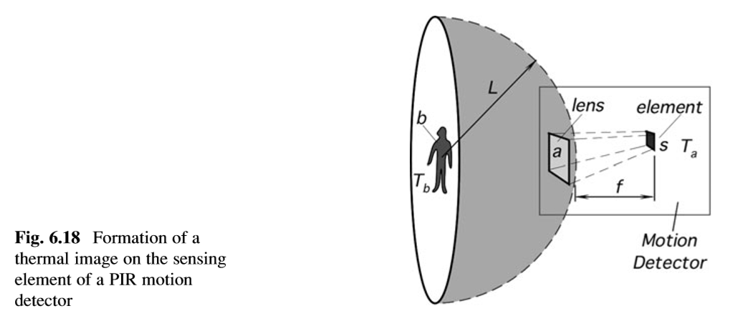
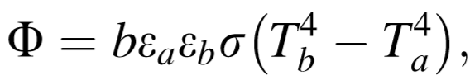
PIR Sensor Efﬁciency Analysis
All objects emanate thermal radiation from their surfaces and intensity of that radiation is governed by the Stefan-Boltzmann law.

Slide 13
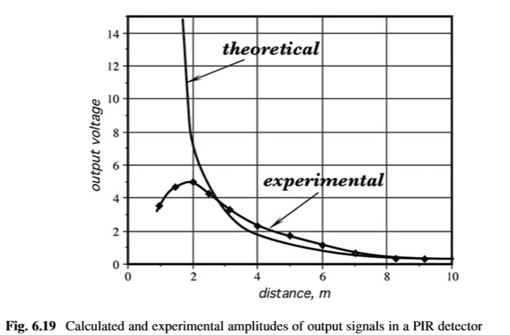
PIR Sensor Efﬁciency Analysis Output

Slide 14
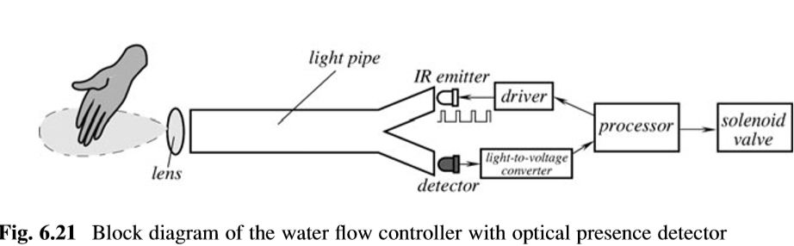
Optical Presence Sensors
A reﬂection of light is the optical phenomenon that is used quite extensively in detecting not only motion. The operating principle is very simple. The sensor contains two key components: a source of light and a photodetector. The LED emits a light beam that illuminates surroundings in the ﬁeld of view of the photodetector.

Slide 15
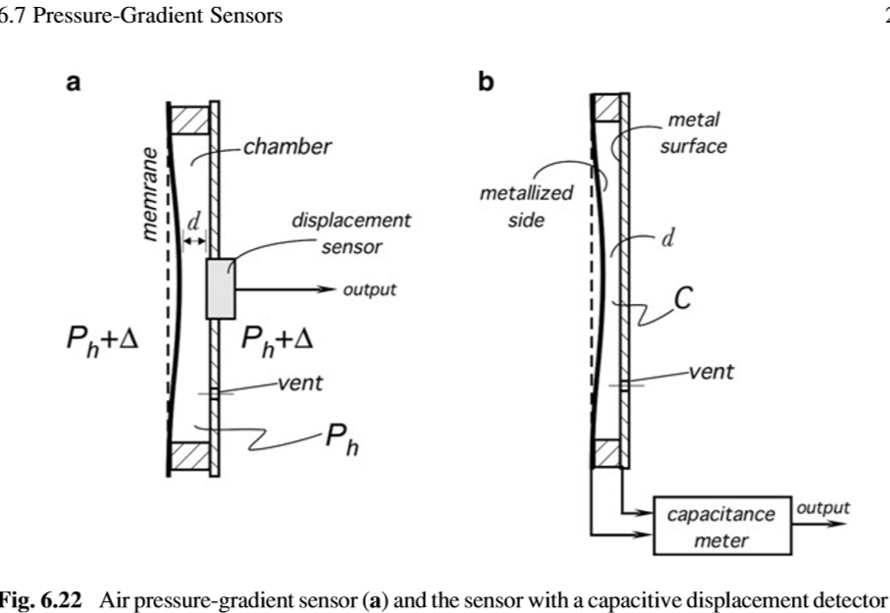
Pressure-Gradient Sensors
An efﬁcient sensor can be designed to detect interruption into a closed room by monitoring small variations in the atmospheric air pressure resulted from opening doors and windows or movement of people.

